Slide 1
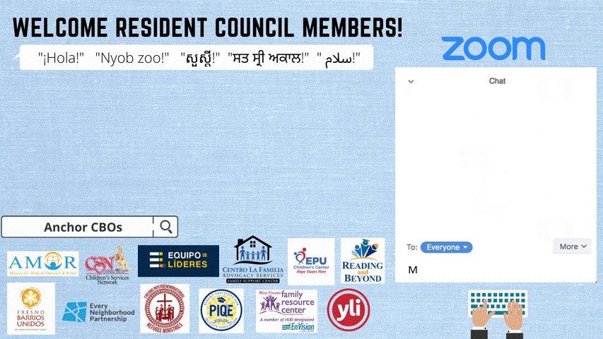

Slide 2
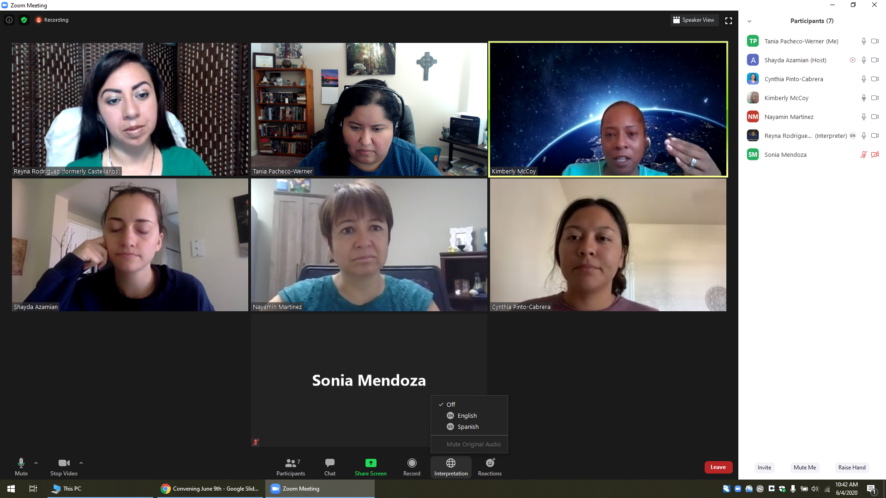
Welcome, Instructions for Zoom
Bienvenidos, Instrucciones para Zoom
Select the World Icon, Then Pick Your Prefered Language
Selecciona el Icono de Mundo, Elije Tu Idioma Preferido
The meeting will have simultaneous interpreting, so you are welcome to comment in your native language.
La junta será interpretada simultáneamente, así que le invitamos a que haga comentarios en su lenguaje nativo.
Tech support:
Para Apoyo Técnico:
Notes:
Nayamin

Slide 3

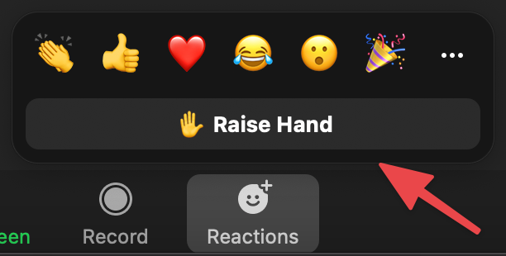
Let’s review our Norms...
1. Be open to new ideas
2. Listen to each speaker
3. Make equal time for all to share
4. In person meeting: Please keep your phone on silent, and if you
need to answer the phone, please excuse yourself from the room
5. During a virtual meeting we encourage you to have the camera on
to be fully engaged, keep your audio on mute
6. Treat others the way you would like to be treated
7. Use the hand icon if you have a question or comment, or put it in
the chat.
Notes:
Wendy 2 min

Slide 4
Vocabulary
Caucus - a group of people united to promote an agreed-upon cause.
System - a set of things working together as parts of an interconnecting network
Policy - a rule for how a system works
Power - the ability to act
Deliberation- the act of thinking about or discussing something and deciding carefully.
Power-Sharing- a policy agreed between political parties or within a coalition to share responsibility for decision-making and political action.
Strategy- a plan of action or policy designed to achieve a major or overall aim.
Notes:
Wendy reviews vocabulary 3 min

Slide 5

OUTCOME FOR THIS MEETING
Today we will review the issues from December’s Issues Assembly and select an issue caucus
Notes:
Mike 2 min

Slide 6


Review REAP Trainings
Leading with a Vision
Established a Vision (values that drive us) and Mission (communicates purpose & action of the vision) for the Residents Council
Community Organizing
Learned how to build a public relationship through one-on-one meetings as the foundation for community organizing
Understanding the Fresno Landscape
Understanding of systems thinking to move from identifying an issue to changing a policy
Problems to Policies
Our power to identify a problem and move toward a policy change
Problems to Policies II
Learned what a research meeting is in the process of policy change
All Training materials accessible in the Residents Council Google Folder [LINK]
Notes:
Training #1 hosted by Wendy Hernandez & Mike, Training #2 hosted by Hope (WFFRC), Training #3 hosted by Artie Padilla, Training #4 hosted by Daniel Dominguez (ENP) & Brianna Zweifler, Angelica Garcia, and Nydia Hernandez (FBU), Training #5 hosted by Christine Barker (FIRM)

Slide 7


Slide 8

Mental health
Fresno Residents Council
Final Issue Areas
Childcare & workers' rights for economic opportunities for families
Affordable housing in healthy communities with access to public services & infrastructure
Safe & inclusive schools for all

Slide 9




Fresno Residents Council
Round 2 Results
Mental health
Safe & inclusive schools for all
Affordable housing in healthy communities with access to public services & infrastructure
Childcare & workers' rights for economic opportunities for families
Schools as a community for all
Healthy communities
Digital literacy & access to technology
Support for children with disabilities and their families
Housing
Childcare
Academic Success
Access to adequate public services & infrastructure
Workers rights & economic opportunities for families

Slide 10

Residents Council Timeline (Jan 2022-May 2022)
Feb 15th
Share issue descriptions with the Leadership Council and all pilot participants
March 15th
Review and select questions for the discussion with Leaders
Apr 19th
Internal discussions after ther exchange meeting
Dec 10th
Issues Assembly
Begin question development
End of Term Celebration (TBD)
2022
End of Year 1
Dec
Jan
Feb
Mar
Apr
May
Jan 25th
Build specifics for issue areas and begin research
March 21-31
Meeting for question exchange and initial discussions with Leaders
May 2nd
Joint deliberative meeting with Leaders and align on one decision; Other groups have identified focus for Year 2

Slide 11
ISSUE CAUCUSES MEETING STRUCTURE
Gather Residents Council members together
Brief introduction
Breakout groups into their issue caucus
Meeting will be facilitated by a TCM organizer and supported by Core Team members
Reconvene all the Residents Council members
Briefly share an overview from each caucus
Announce next steps for the next meeting
Conclude Meeting
*If a caucus is in need of more time for discussion, a separate meeting can be scheduled

Slide 12

Why, How, What?
“Why” will always drive this work with the vision in mind created with our values.
“How” will include our mission statement and goals to achieve in this process.
“What” is the product we will create in the end together.
These are the Big Ideas!
Notes:
Mike explains the Golden Circle 5 min

Slide 13

Strategy Overview
What is the purpose behind Issue Caucus Meetings?
To understand the issue in depth (system thinking) as we move toward an effort for policy change.
Caucus is our opportunity to deliberate together.
Outcome= determine a joint strategy on how to achieve our policy goals

Slide 14
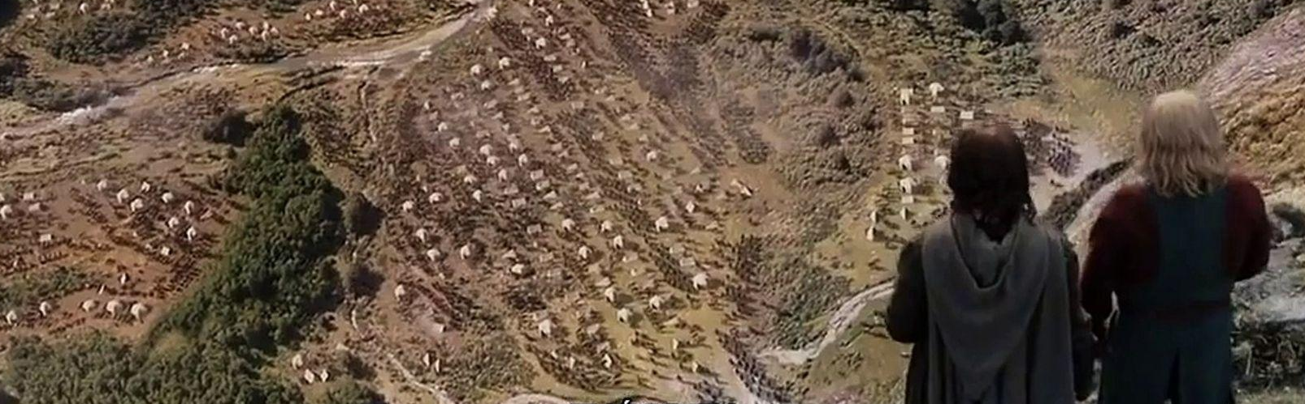
Strategy Overview
What is strategy?
Strategy = Strategos = “Generalship”
Like a general overseeing a battlefield
We must agree on how we will achieve victory, but…
First we need to define what victory means: what do we want to achieve?

Slide 15
Homework
Select an Issue Caucus using the Google survey:
English: [LINK] | Spanish: [LINK]
Hmong: [LINK] | Arabic: [LINK]

Slide 16

Next Meetings Dates
Residents Council Terms
Term |  | Dates
Year 1 | Fall 2021 | July-December 2021
 | Spring 2022 | January-May 2022
Year 2 | Fall 2022 | July-December 2022
 | Spring 2023 | January-May 2023
Spring 2022 Meeting Schedule
Residents Council Meetings
January 25, 2022
February 15, 2022
March 15, 2022
April 19, 2022
Special Events
Meeting | Tentative Date
Leaders & Residents Meeting 1 | Week of March 22, 2022
Leaders & Residents Meeting 2 | Week of May 2, 2022
End of Term Ceremony | May (Date TBD)
*Residents Council Meetings will be held once a month virtually. Dates for the Special Events will be announced at a later time.

Slide 17

Announcements
Stipend Payments have been processed and is being currently being distributed
E-Payments should be accessible by Friday
Checks should arrive the 1st week of February
*If an issue arises with your stipend payment, please contact Pen at pen@tcmfresno.org

Slide 18

Next Meeting
Issue Caucuses First Research Meeting: Developing Questions
Tuesday, February 15th from 5:30pm-7pm

